Slide 1

Library Management System
Pavana Krishna Chunduru(700647307)

Slide 2
Contents
What is Library System about?
Use Case Diagram
Functions of the actors
Use case diagrams
Activity diagrams
Entity-class diagrams
Sequence diagrams
Complete class diagram

Slide 3
What is Library System about?
A library system is needed to keep track of all the activities that revolve in and around the library.
When broadly categorized we find that the major constituents of a library are patrons, librarian and system administrator.
There are a number of activities which are performed by each person in these three categories.
Lets now discuss about the library system with the help of a use case diagram.

Slide 4
Use Case Diagram:
UML, a visual language that lets us model processes is used to draw Use case diagrams.
Use case diagrams specifies the static aspects of a system.
Captures the functional requirements of the system and also depicts the interaction between the actors (users) and the product.

Slide 5
Functions of the actors
Patron:
Search the catalogue for Library Material
Borrow the Library Media/Material
Return the Library Material/Media
Librarian:
Update the Patrons Information
Search the Catalogue and Issuing the Material to the Patrons
Remove the Damaged Media and Renew the Library Material
Billing Payment information details as per the usage of the Library Details

Slide 6
Functions of the actors(contd.)
System Administrator:
Add Patrons and Librarians accounts
Update all users information
Issuance of privileges to users

Slide 7
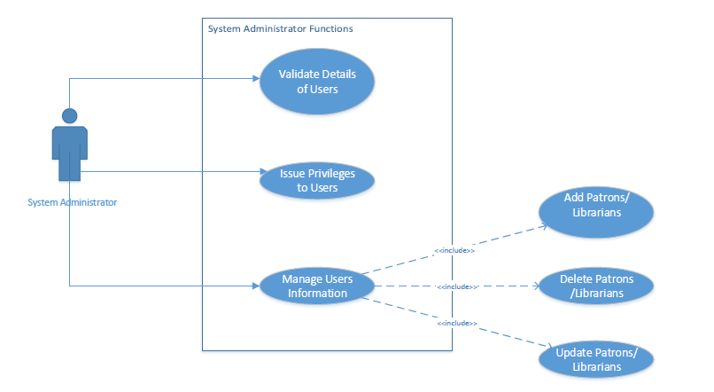
Use case diagram: System Administrator

Slide 8
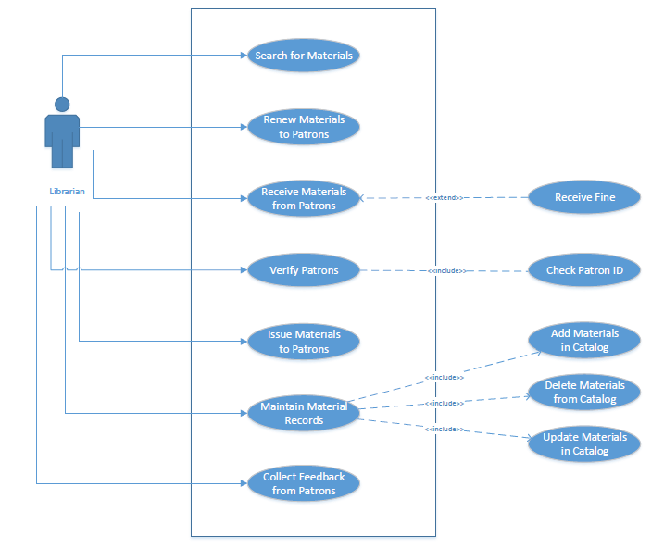
Use case diagram: Librarian

Slide 9
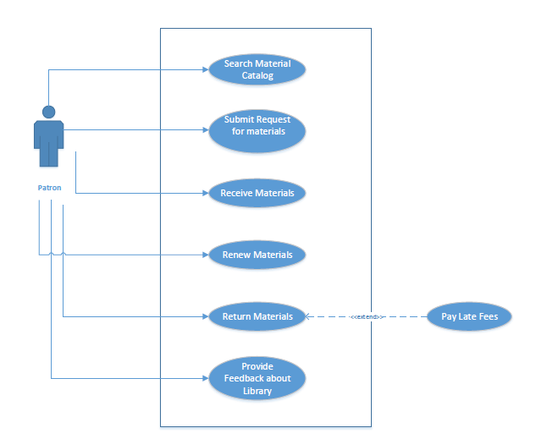
Use case diagram: Patron

Slide 10
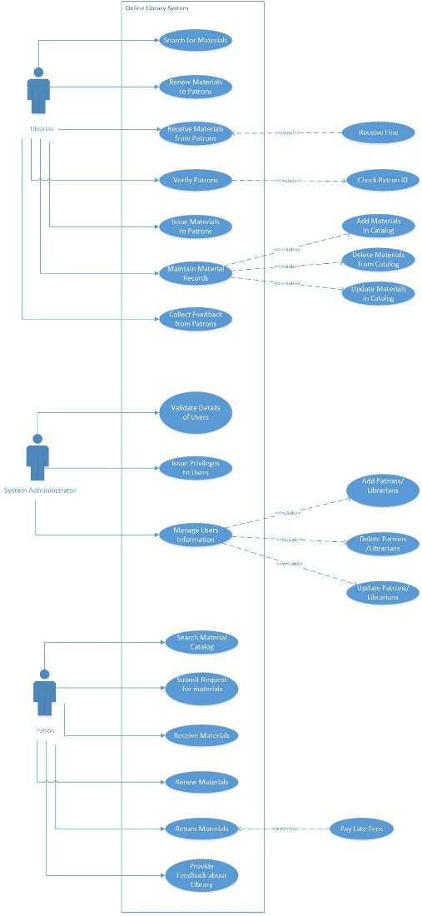
Use case diagram for the system

Slide 11
Activity Diagram
Captures the dynamic behavior of the system.
Activity diagrams show the overall flow of control.
Rounded rectangles represent actions
Diamonds represent decisions
Bars represent the start (fork) or end (join) of concurrent activities
A black circle represents the start (initial state) of the workflow
An encircled black circle represents the end

Slide 12
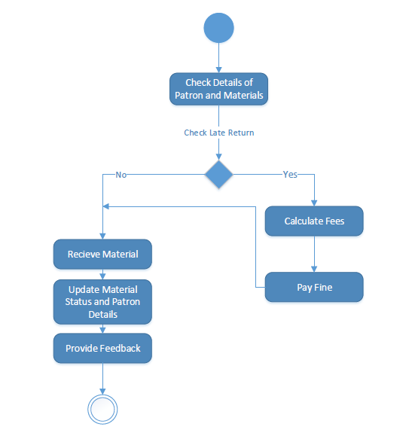
Activity diagram for returning a material:

Slide 13
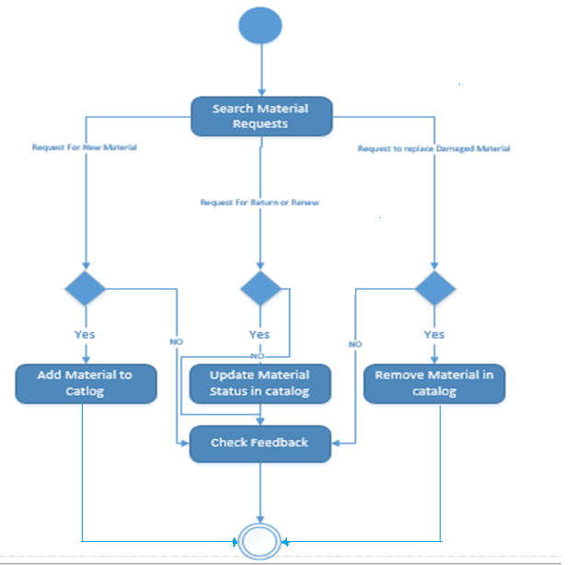
Activity diagram for updating materials:

Slide 14
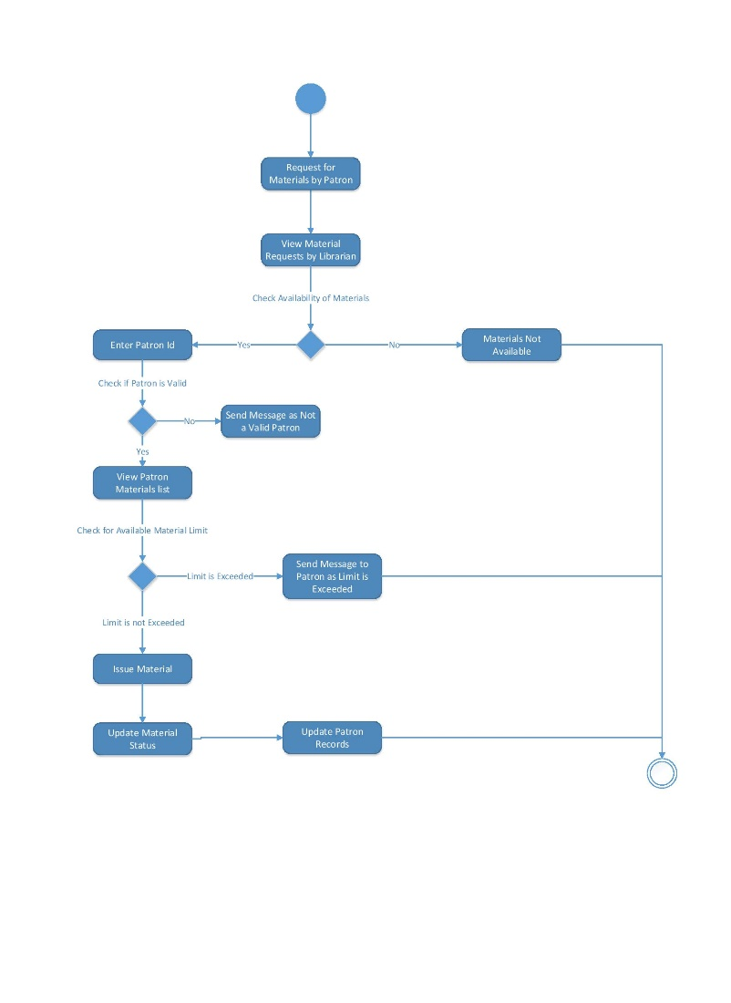
Activity diagram for issuing a material:

Slide 15
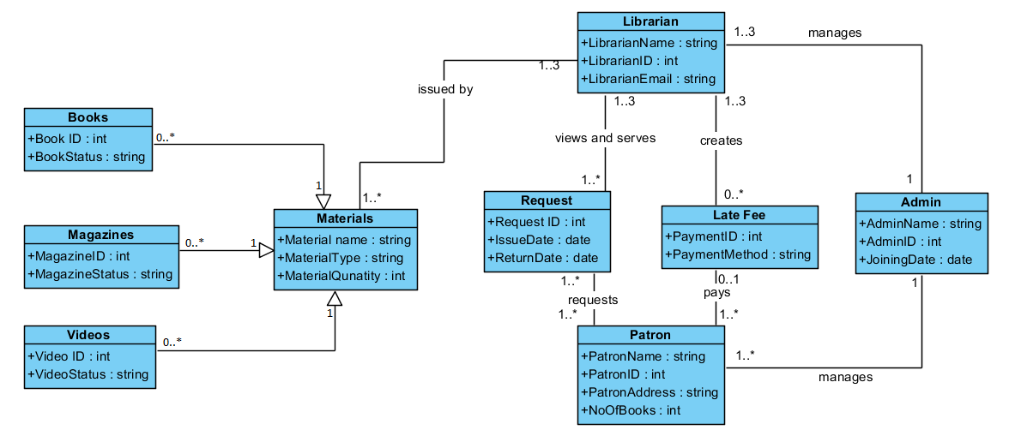
Entity class diagram:

Slide 16
Sequence Diagram
Interaction diagram that shows how processes operate with one another and in what order.
It shows object interactions arranged in time sequence.
It depicts the objects and classes involved in the scenario and the sequence of messages exchanged between the objects .
It shows, as parallel vertical lines, different processes or objects that live simultaneously.
Solid arrow heads represent synchronous calls and dashed lines represent reply messages.

Slide 17
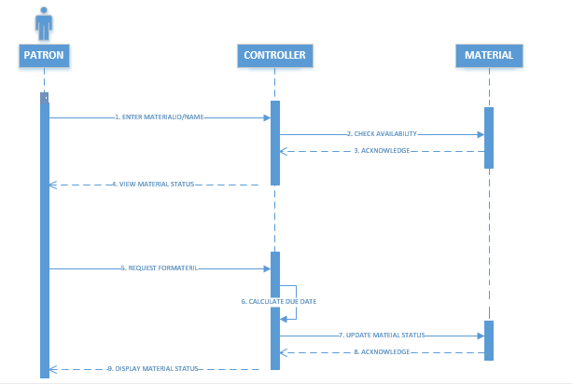
Sequence diagram for borrowing material:

Slide 18
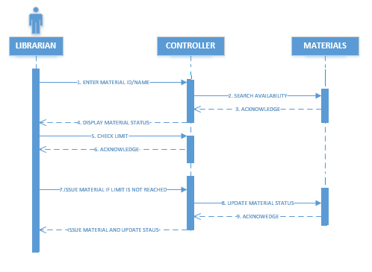
Sequence diagram for issuing material:

Slide 19
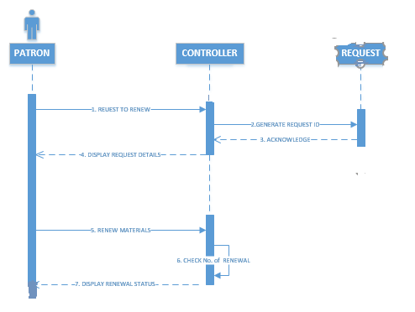
Sequence diagram for renewal of material:

Slide 20
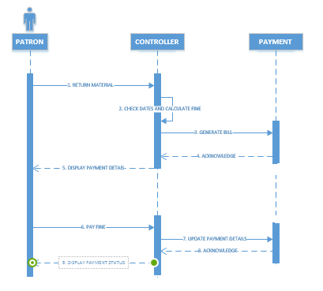
Sequence diagram for returning material:

Slide 21
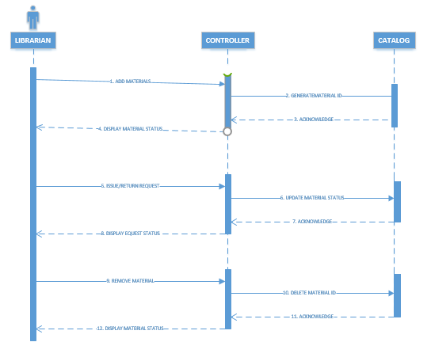
Sequence diagram for updating material:

Slide 22
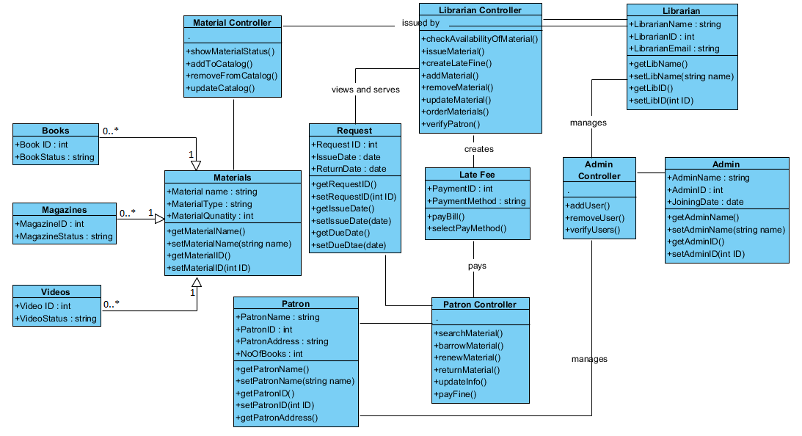
Complete class diagram:

Slide 23
Thank You!!

